Slide 1
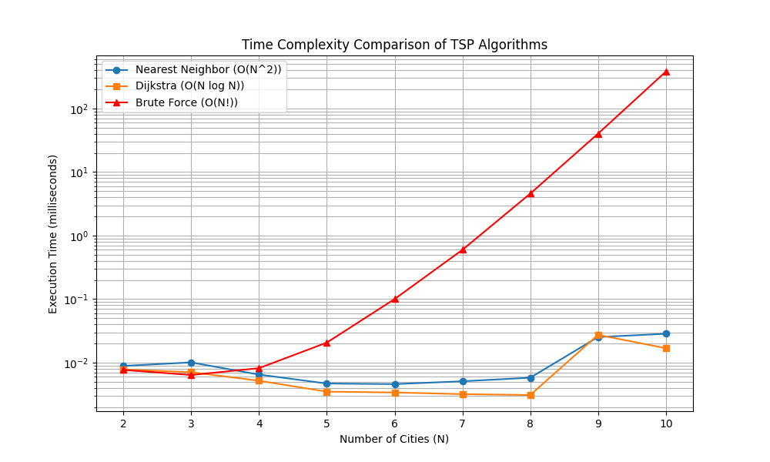
TSP Project :
Comprehensive Algorithm
Report
16/12/2025
Xavier KNOEPFFLER-POUT | Omais RANA
1/14

Slide 2
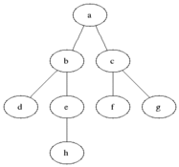
Part 1 : Checking Connectivity
- Is a tour even possible ?
We using BFS to verify :
- Complexity analysis :
2/14

Slide 3


Part 2 : Actually solving the TSP
Nearest Neighbour
B
C
15
50
A
D
8
3/14

Slide 4
Upsides and Downsides
-Very fast
-Very easy to implement
-Short-sighted (doesn’t think for future commands)
-Greedy (makes it choises very early on)
-can lead to long legs at the end of the tour
4/14

Slide 5
Dijkstra
5/14

Slide 6
Upsides and Downsides
-Ignores what would be the best connection
-reuses lengths way too many times
-This is just an example that not every algorithm is good for every situation
-Very Fast
6/14

Slide 7
Brute Force
C
B
D
A
7/14

Slide 8
Upsides and Downsides
-The best direction will be found.
-Really slow
-Only physically possible with graphs with low numbers of N
8/14

Slide 9
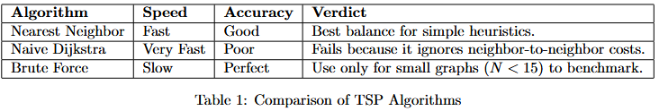
What is the best to use out of these ?
9/14

Slide 10
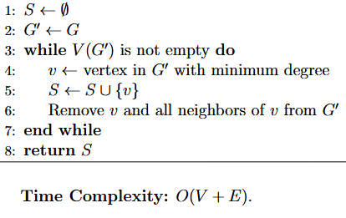
Exercice 9
Maximum Independent Set |(MIS)|
-Independant sets are sets in a graph where no two vertices are adjacent.
Real World application :
°Wireless Interference Reduction|
-Permits transmits on the same
frequency
°Exam Timetabling|
Indepent sets reprenting course
That can be scheduled
10/14

Slide 11
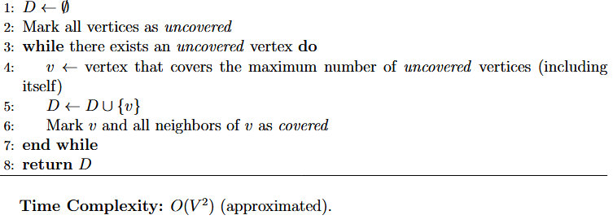
Maximum Independent Set |(MDS)|
-a subset of verices D such that every vertex in the graph is either in D or ajacent to a vertex in D.
Real World application :
°Network monitoring| Making sure every computer is its own server or can easily connect to one
°Facility Location|
Placing emergency
Locations.
MDS ensures every
Place has a station
11/14

Slide 12
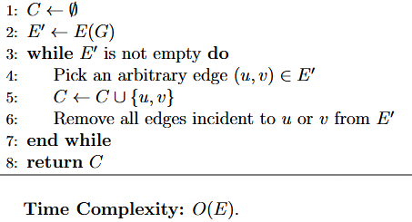
Vertex Cover
-Vertex Cover means any vertices that touches every edge in a graph
The goal is to find the smallest number of vertices
Real World application :
°Traffic Camera Placement|
°Network Security Patches| if a virus spreads
A vertex cover ensures a removal of a link
Between patched machines
12/14

Slide 13
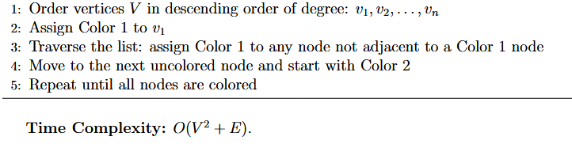
Graph Coloring
-Assigning colors to every node so that no two adjacent nodes share
the same color
Real World application :
°Frequency Assignment| in cellular network, it allows to not step on each other’s frequencies
°Register Allocation|
CPU registers cannot be
Shared.Coloring minimizes
The register needed.
Welsh-Powel Algorithm
13/14

Slide 14
This would be our explanation
on the subject !
14/14

